Slide 1
Homework, Context & Keywords
Homework
Read Chapter 11.1 – 11.6 of Nelson Unit 1 & 2, page 358-398 and summarise the relevant points

Slide 2
Light Duality
Year 12

Slide 3
Page Set up
Set up the first page of every lesson like this and rule a column line for every page after the first page that is used during the lesson.
Focus: State the Chapter Number, Title and the page numbers (3 lines).
Keywords: During the lesson write out your own keywords used during the lesson. (8 lines)
Context: During the lesson write in this section what this topic relates to in the ‘real’ world. How is this content used to better society? (5 lines)

Slide 4
Light Waves
Unit 1&2
Chapter 11.1 – 11.6
Pages 358 - 398

Slide 5
Two Categories of Waves
Mechanical waves, e.g. sound, require a medium due to the particles need for a medium to travel. These include;
Transverse Waves
Longitudinal Waves
Non-mechanical waves, e.g. light, doesn’t need require a medium to travel. (Light can travel through a vacuum and also light can have mechanical properties).

Slide 6
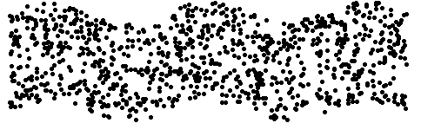
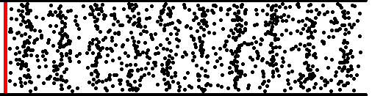
TRANSVERSE WAVE IN A LIQUID
LONGITUDINAL WAVE IN A GAS

Slide 7
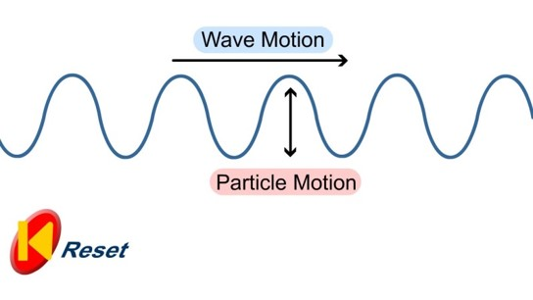
Transverse NON-Mechanical Wave
Where particles vibrate in a direction perpendicular to that of the energy flow.
Examples: Electromagnetic (Light, Radio, X-ray) waves
Energy Flow
Amplitude

Slide 8
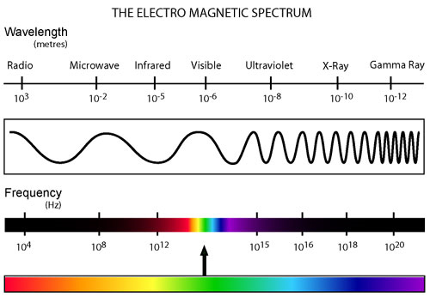
Family of Electromagnetic Radiation

Slide 9
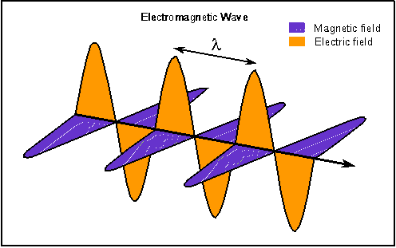
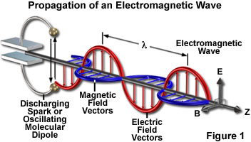
Family of Electromagnetic Radiation
Electro..... Magnetic!
c = f λ, where c is constant. The waves are in phase

Slide 10
Production of EM Waves
An accelerating charged particle produces an electromagnetic (EM) wave.
Electromagnetic waves are electric and magnetic fields traveling through empty space with the speed of light c.
A charged particle oscillating about an equilibrium position is an accelerating charged particle.
If its frequency of oscillation is f, then it produces an electromagnetic wave with frequency f.

Slide 11
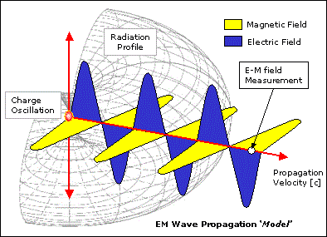
Production of EM Waves

Slide 12
Production of EM Waves
Accelerating a particle with a charge produces a changing electric field.
This changing electric field produces a changing magnetic field and the changing magnetic field produces a changing electric fields.
This interplay between these induced electric and magnetic fields leads to propagating electromagnetic waves.

Slide 13
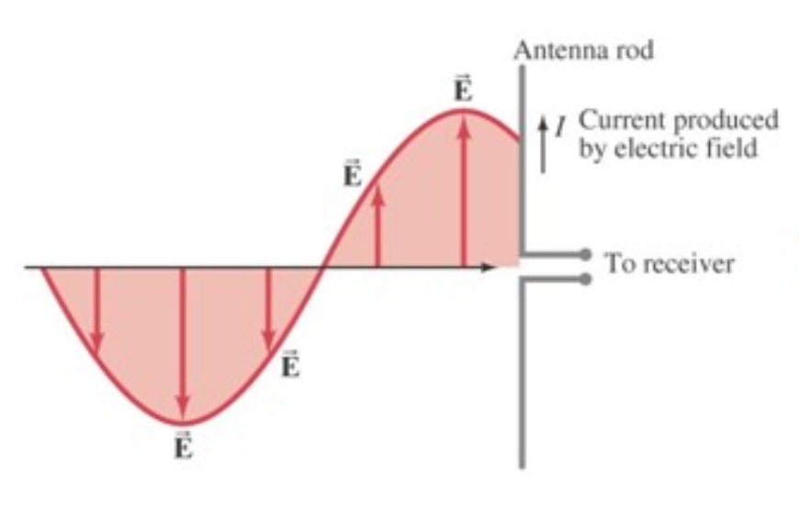
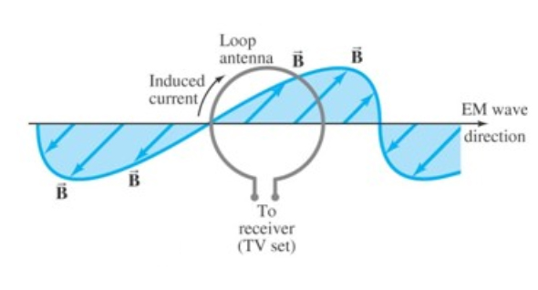
Transmission ANTENNAS
Two types
Electric Field Antenna Magnetic Field Antenna

Slide 14
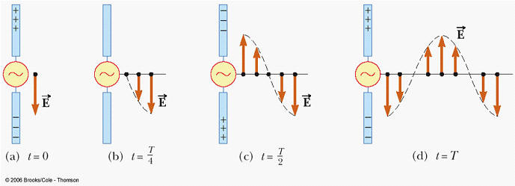
Transmission ANTENNAS
Electric Field Antenna
An oscillating potential difference through two parts of dipole antenna induces an oscillating current.
This current oscillates at a frequency that produces an electric field. That oscillating electric field produces an oscillating
magnetic field.
These combine to become an EM
wave of that oscillating frequency
that then transmits that signal to
the receiver antennas.

Slide 15
Transmission ANTENNAS
Magnetic Field Antenna
An induced AC current flows around the ring producing a magnet field.
That magnet field produces an oscillating electric field. This in turn produces an oscillating magnetic field.
The combination of these becomes an EM wave of that oscillating frequency that then transmits that signal to the receiver antennas.

Slide 16
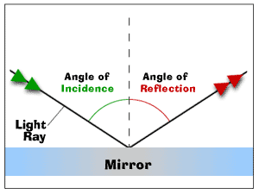
Reflection
When the wave does not pass through
the solid barrier it encounters. The light
ray that hits the mirror is called the
incident ray. The light ray that bounces
off the mirror is called the reflected ray.
Law of reflection
Angle of incidence (θ_{i}) = Angle of reflection (θ_{r})
Incidence ray and reflected ray are on the opposite sides of the normal.

Slide 17
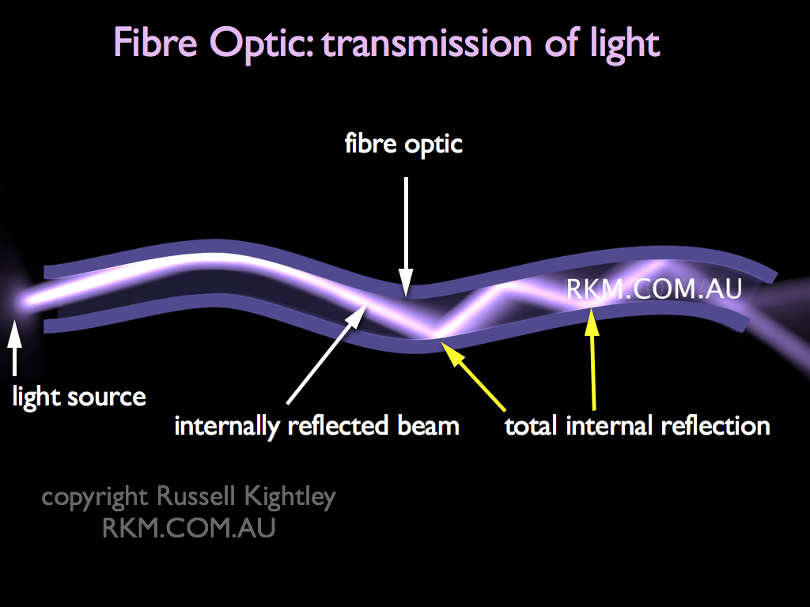
Optic Fibres
Fibre-optic lines are strands of optically pure glass as thin as a human hair that carry digital information in the form of light pulses over long distances.
Cables can bend as the system relies on reflection to keep the light pulse within the glass strand. Very
little light is absorbed by the glass.
Light getting in at one end undergoes
repeated total internal reflection,
even when the fibre is bent, and
emerges at the other end.

Slide 18
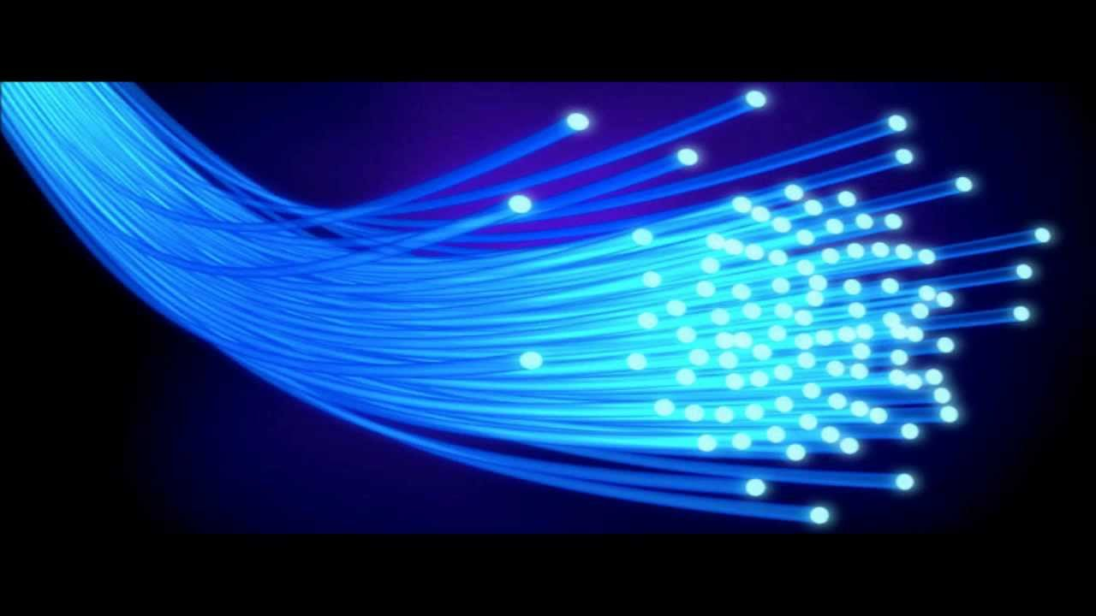
Optic Fibres
The speed of light is approximately 300,000,000 metres per second. Fibre optic networks, which carry laser light information signals, are moving that speed.
As the laser-generated pulses of light reach the subscriber's home, a converter changes them into the electrical impulses that
computers use. They are also
used in medical imaging and
mechanical engineering
inspection.

Slide 19
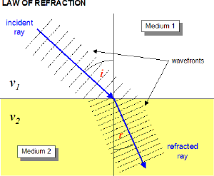
Refraction
c = λ × f
Refraction occurs in waves travelling from one medium to another medium at an oblique angle.
At the boundary between the media, the wave's phase velocity is altered, usually causing a change in direction.
The wavelength also increases or decreases as the frequency remains constant.

Slide 20
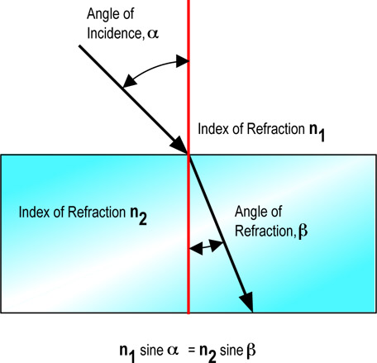
Refraction
Refraction is the bending of a wave when it enters a medium resulting in a change in speed.
The refraction of light when it passes from a “less dense” medium to a “more dense” medium bends the light ray toward the normal to the boundary between the two media.
Angle of Incidence, i
Index of Refraction, n₁
Index of Refraction, n₂
Angle of Refraction, r

Slide 21
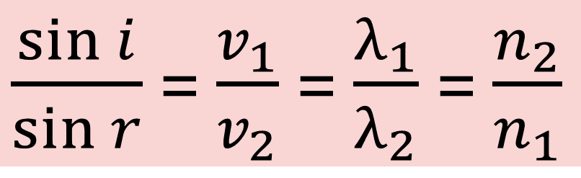
Snell’s Law
Angle of Incidence, i
$\frac{\sin{i}}{\sin{r}}$ = $\frac{v_{1}}{v_{2}}$ = $\frac{λ_{1}}{λ_{2}}$ = $\frac{n_{2}}{n_{1}}$
Index of Refraction, n₁
Refrangibility is the measure of refraction when light passes from a vacuum to a medium.
The refractive index for a vacuum is 1.00.
Index of Refraction, n₂
Angle of Refraction, r

Slide 22
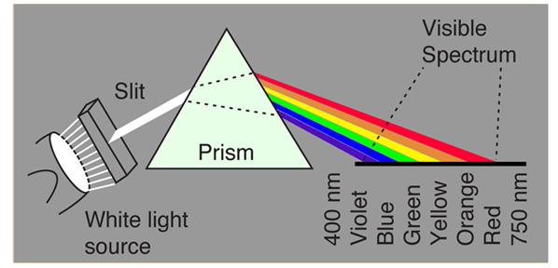
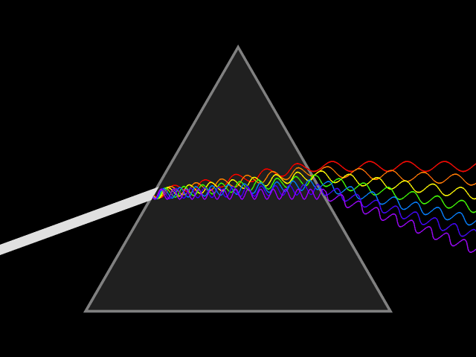
Dispersion
Remember in refraction the frequency remains constant.
Generally, blue light traveling more slowly in the prism than red light which then causes the blue to move more towards the normal.

Slide 23
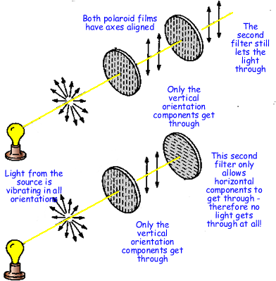
Polarisation
Applicable only to transverse waves (longitudinal waves cannot be polarised).
Hence proof that light waves (the wave component of light) acts as a Transverse wave.

Slide 24
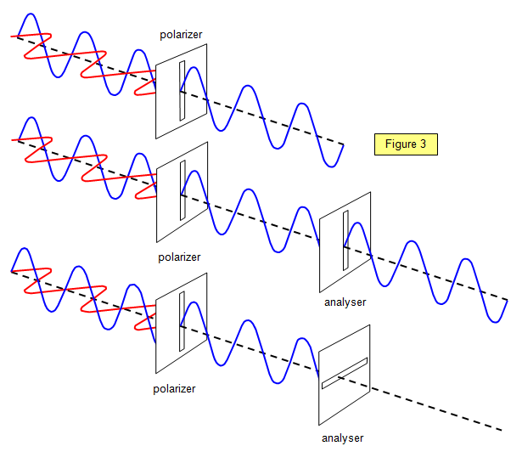
Polarisation
With polarisation, consider the effect on the electric component of the EM when passed through the polarising planes.

Slide 25
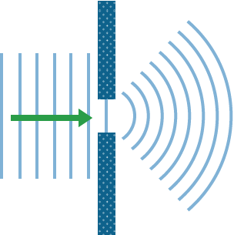
Diffraction
Diffraction is the slight bending of light as it passes around the edge of an object or through a slit.
The amount of bending
depends on the relative
size of the wavelength of
light to the size of the
opening.

Slide 26
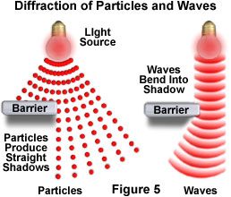
Diffraction of Light
Diffraction; or the bending of light, is indicative of the properties of waves, more specifically TRANSVERSE WAVES.

Slide 27
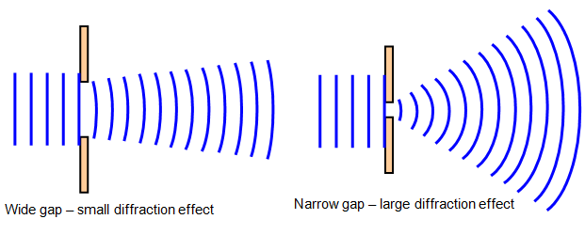
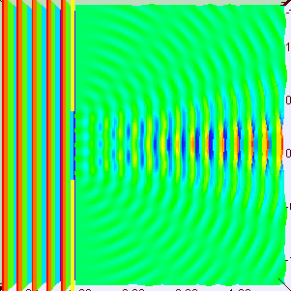
Small Diffraction Angle
θ = λ
w
θ
λ
w

Slide 28
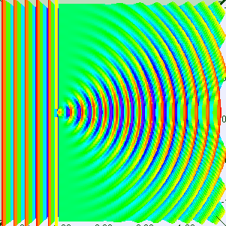
Large Diffraction Angle
θ = λ
w
λ
θ
w

Slide 29
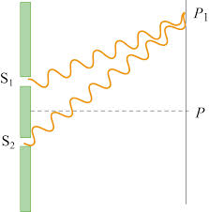
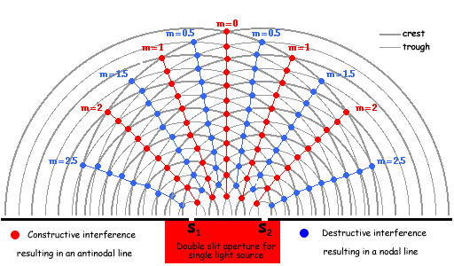
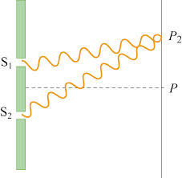
Interference
Constructive Interference
Destructive Interference

Slide 30
Homework, Context & Keywords
Context: How is this content used to better society?
Transmission of information has followed the principles and Laws associated with Electromagnetic Radiation. By improving our understanding of this phenomena we can improve on this technology.

Slide 31
Homework, Context & Keywords
Key Words
Diffraction
Interference
Polarisation
Electromagnetic
Transverse
Oscillation
Electric
Magnetic
Reflection
Refraction
Dispersion

Slide 32
Homework, Context & Keywords
Homework
Read Chapter 7.1, page 204-208 and answer
Q1 & Q2 Set 7.1
by next lesson.

Slide 33
Page Set up
Set up the first page of every lesson like this and rule a column line for every page after the first page that is used during the lesson.
Focus: State the Chapter Number, Title and the page numbers (3 lines).
Keywords: During the lesson write out your own keywords used during the lesson. (8 lines)
Context: During the lesson write in this section what this topic relates to in the ‘real’ world. How is this content used to better society? (5 lines)

Slide 34
Light AS A WAVE
Chapter 7.1
Pages 204 – 208

Slide 35
PRINCIPLES OF DUALITY

Slide 36
Principles of Duality
Light is usually described as being both
particle-like (e.g. photoelectric effect) and
wave-like (e.g. Young’s double slit experiment)
in its behaviour.

Slide 37
Principles of Duality
Behaviour of light as particles | Behaviour of light as waves
Linear propagation | Linear propagation
Intensity reduces with the square of the distance from the source | Intensity reduces with the square of the distance from the source
Reflection | Reflection
 | Refraction
Modelling of light paths around mirrors and lenses with geometric optics | Modelling of light paths around mirrors and lenses with wave optics
 | Light beams crossing paths undisturbed (no change to the individual energies)
 | Partial reflection and transmission of light at a boundary
 | Diffraction
Photoelectric effect

Slide 38
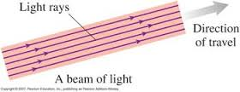
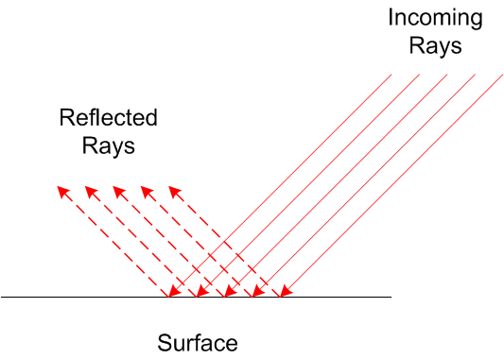
Principles of Duality - RAY MODEL
Straight line.
Changes directions when interacting with materials.

Slide 39
Principles of Duality - Wave Model
Interference and Diffraction.
Electromagnetic wave in a vacuum or a medium.

Slide 40
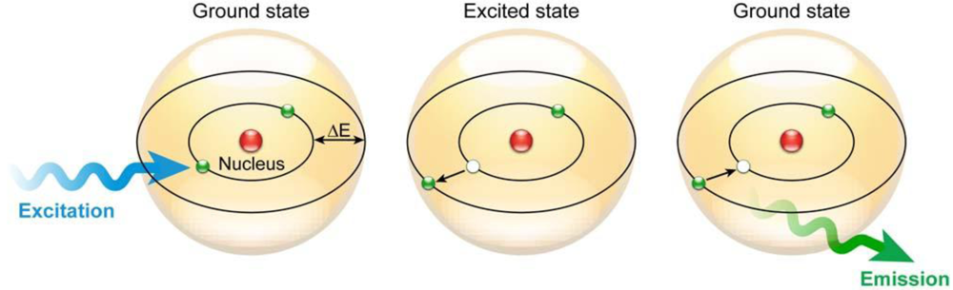
Principles of Duality - Photon Model
Photons act as packets of particles that allows interaction with atoms.

Slide 41
LIGHT AS A WAVE

Slide 42
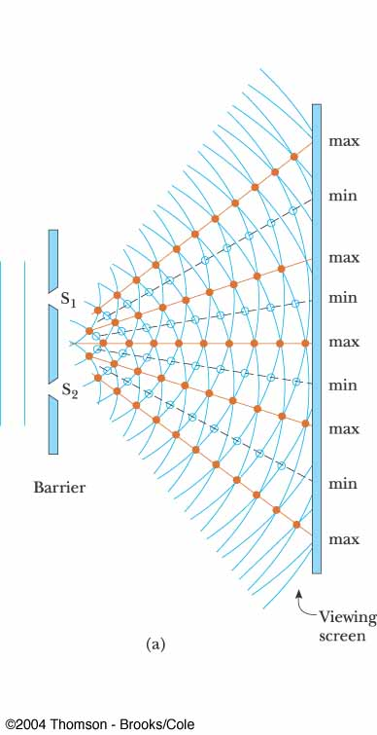
LIGHT AS A Wave
The interference pattern produced on the viewing screen had strong similarities to that which occurs where water or sound waves are treated in the same manner.
This can only be explained through the behaviour of transverse waves.

Slide 43
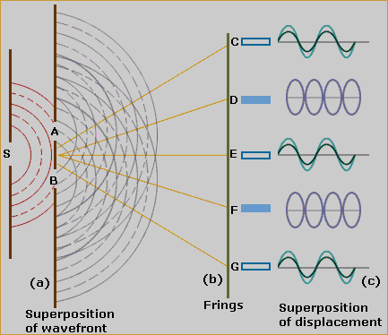
LIGHT AS A Wave
The diffraction pattern, produced nodal (dark patches), like D and F. Also there are anti-nodal (bright patches), like C, E and G where the light waves interact.

Slide 44
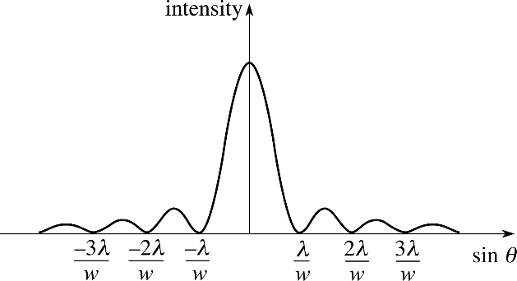
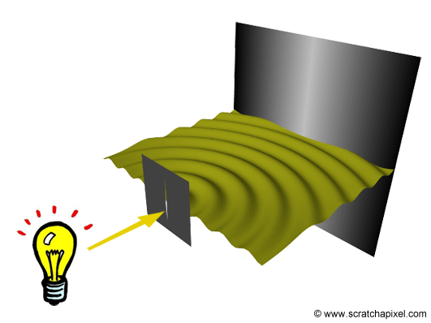
Single Wave Intensity
The diffraction pattern, above, is taken with a laser and a narrow single slit.

Slide 45
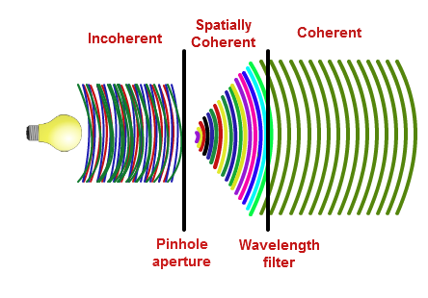
Single Wave Intensity

Slide 46
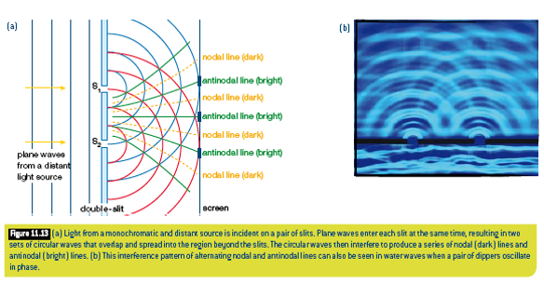
Young's Double Slit Experiment
Monochromatic light is light consisting of only one wavelength.

Slide 47
Interference
Constructive Interference
Destructive Interference

Slide 48
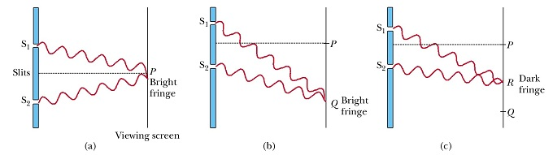
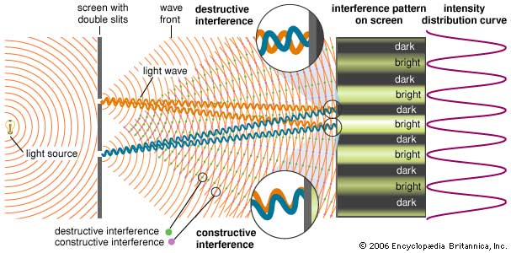
Interference

Slide 49
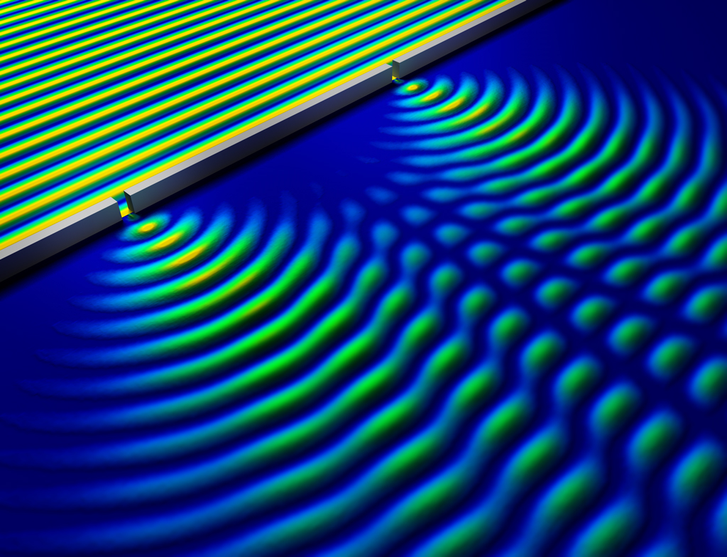
Path Difference
d
There is a centre point where all nodes and antinodes stem from. It is half the distance between the two slits.
½d
Bright (anti-nodal & maximum)
Dark (nodal & minimum)
Bright (anti-nodal & maximum)
Dark (nodal & minimum)
Bright (anti-nodal & maximum)

Slide 50
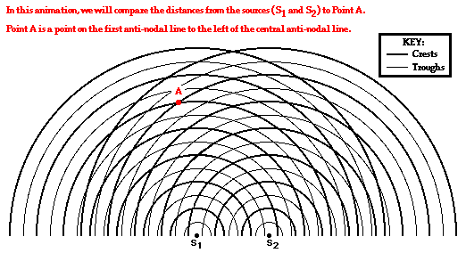
Path Difference
Simply put, the path difference is the difference in the distances that the two wave fronts have to travel in order to reach a set location, measured in terms of wavelength.
Here we compare the distance from the sources (S₁ & S₂) to Point A.
Hence the path difference is 1λ

Slide 51
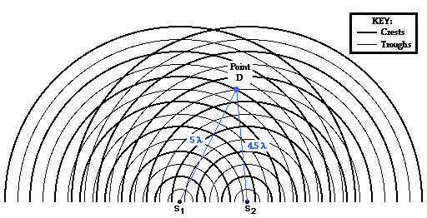
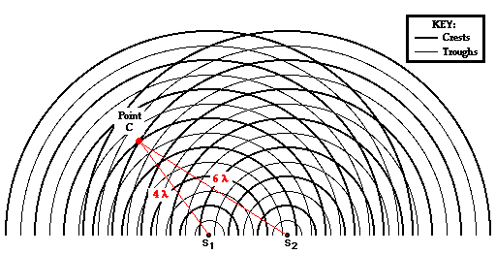
Path Difference
And here the path difference is 2λ
Here we can see the path difference is 0.5λ

Slide 52
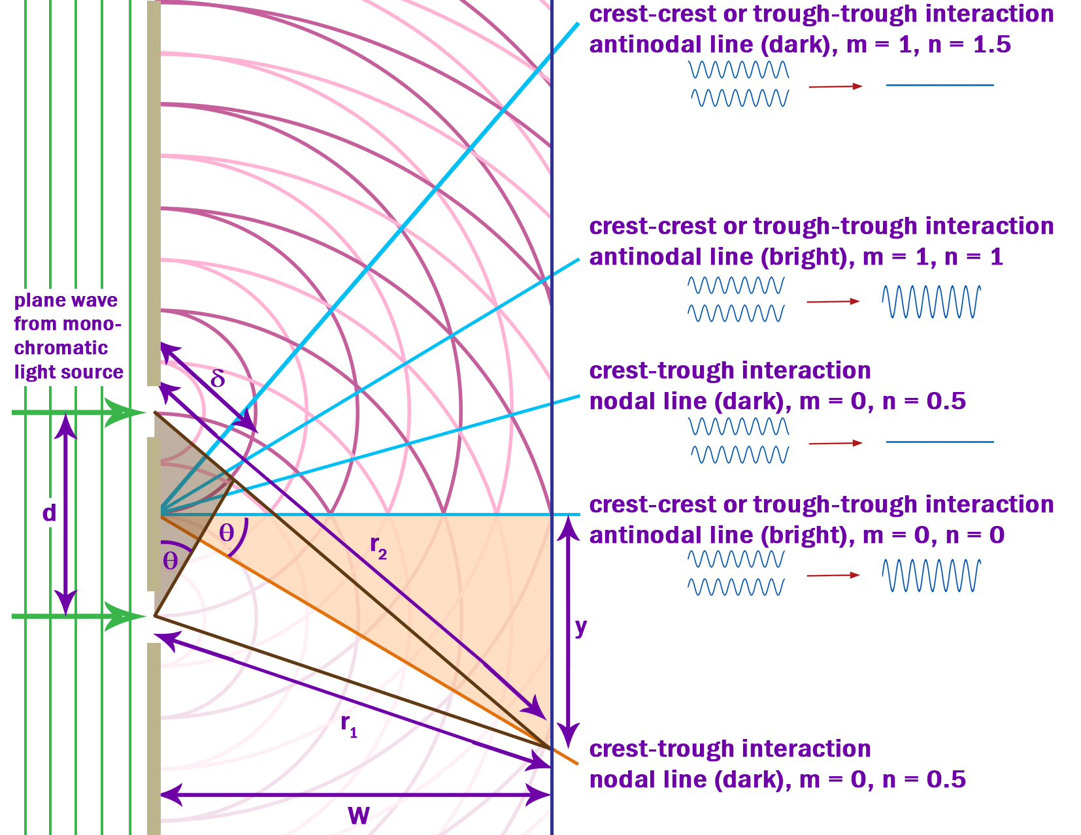
PATH Difference
δ = d sinθ
δ = sinθ = y .
d W
by means of small angles
λ = y d .
L n
where n = 0,.5,1,1.5

Slide 53
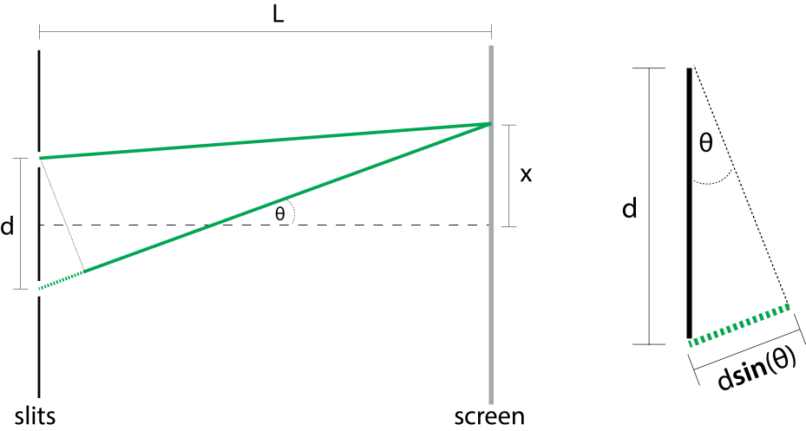
Path Difference
Example 7.1a: In a Young's Double Slit experiment using a laser of wavelength 638 nm, the screen is placed at a distance of 2.5 m from the double slit. If the slit separation is 0.50 mm, what is the distance between fringes?

Slide 54
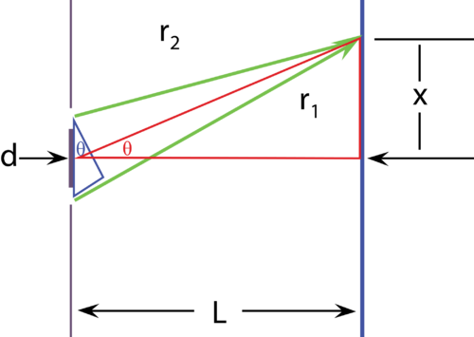
Path Difference
Example 7.1b: A monochromatic laser light is shone on a pair of double slits, 0.15 mm apart, and an interference pattern is observed 2 m from the slits as shown in the figure. The second order bright fringe is 20 mm from the central maxima. What is the wavelength of the light used?

Slide 55
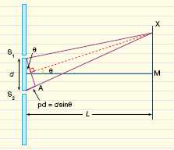
Path Difference
Example 7.1c: Light of an unknown wavelength emitted by a laser is directed through a pair of thin slits separated by 50 μm. The slits are 2.0 m from a screen on which five bright fringes are seen over a width of 12.5 cm from M to X. What colour is the laser light?
x

Slide 56
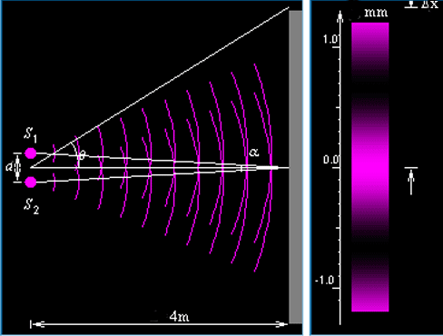
Changing Distance between Slits
Increasing the gap between the slits decreases the distances between the maximum intensity point.
Δx = λ n L . d

Slide 57
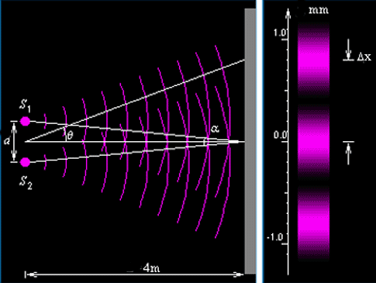
Changing Wavelength
Increasing the wavelength (purple has a short wavelength in comparison to red), increases the distances between the maximum intensity point.
Δx = λ n L . d

Slide 58
Homework, Context & Keywords
Context: How is this content used to better society?
The different behaviours of light particles can be manipulated to suit a variety of modern technological advances. By improving our understanding of this phenomena we can improve on this technology.

Slide 59
Homework, Context & Keywords
Key Words
Bright
Dark
Nodal
Antinodal
Transverse
Duality
Interference
Diffraction
Path Difference
Wavelength
Maxima
Minima
Fringe

Slide 60
Homework, Context & Keywords
Homework
Complete all questions from Set 7.1 - due first lesson next week.
Read Chapter 7.2, page 208-215 and answer
Q1 & Q2 Set 7.2
by next lesson.

Slide 61
Page Set up
Set up the first page of every lesson like this and rule a column line for every page after the first page that is used during the lesson.
Focus: State the Chapter Number, Title and the page numbers (3 lines).
Keywords: During the lesson write out your own keywords used during the lesson. (8 lines)
Context: During the lesson write in this section what this topic relates to in the ‘real’ world. How is this content used to better society? (5 lines)

Slide 62
QUANTUM
Chapter 7.2
Pages 208 – 215

Slide 63
PRINCIPLES OF DUALITY

Slide 64
Principles of Duality
Light is usually described as being both
particle-like (e.g. photoelectric effect) and
wave-like (e.g. Young’s double slit experiment)
in its behaviour.

Slide 65
Principles of Duality
Behaviour of light as particles | Behaviour of light as waves
Linear propagation | Linear propagation
Intensity reduces with the square of the distance from the source | Intensity reduces with the square of the distance from the source
Reflection | Reflection
 | Refraction
Modelling of light paths around mirrors and lenses with geometric optics | Modelling of light paths around mirrors and lenses with wave optics
 | Light beams crossing paths undisturbed (no change to the individual energies)
 | Partial reflection and transmission of light at a boundary
 | Diffraction
Photoelectric effect

Slide 66
Principles of Duality - RAY MODEL
Straight line.
Changes directions when interacting with materials.

Slide 67
Principles of Duality - Wave Model
Interference and Diffraction.
Electromagnetic wave in a vacuum or a medium.

Slide 68
Principles of Duality - Photon Model
Photons act as packets of particles that allows interaction with atoms.

Slide 69
QUANTA

Slide 70
Black Body Radiation
A black body absorbs all the electromagnetic radiation (including light) that strikes it. To stay in thermal equilibrium, it must emit radiation at the same rate as it absorbs it. This is black body radiation, and it is thermal radiation.
In fact, all objects emit thermal radiation (as long as their temperature is above Absolute Zero, or -273.15 degrees Celsius), but no object emits thermal radiation perfectly; rather, they are better at emitting/absorbing some wavelengths of light than others.
As the temperature of a blackbody increases, the total amount of light emitted per second (intensity) increases, and the wavelength of the spectrum's peak shifts to bluer colours. This means as the object is heated to a high temperature, a blackbody will begin to glow with thermal radiation at peak frequencies.

Slide 71
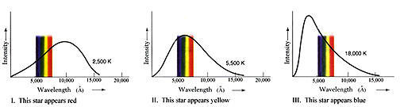
Black Body Radiation
As the temperature of a blackbody increases, the total amount of light emitted per second (intensity) increases, and the wavelength of the spectrum's peak shifts to bluer colours. This means as the object is heated to a high temperature, a blackbody will begin to glow with thermal radiation at peak frequencies.

Slide 72

Wien’s Law

Slide 73
Wien’s Law
λ_{max} = b .
T
λ_{max} – peak wavelength (m)
T – absolute temperature (K)
b – Wien’s constant
b = 2.898 × 10⁻³ m K

Slide 74
Stefan-Boltzmann’s Law
The total power radiated from a black body is given by
P_{b} = σ A T⁴
P_{b} – Power (W or J s⁻¹)
A – surface area emitting radiation (m²)
σ – Stefan-Boltzmann’s constant
σ = 5.699 × 10⁻⁸ W m⁻² K⁻⁴

Slide 75
Stefan-Boltzmann’s & Wien’s Law
Example 7.2a: Determine the wavelength emitted from the human body.
Example 7.2b: Determine the wavelength emitted from the Sun given it has a power output of 3.846 × 10²⁶ W.

Slide 76
PLANCK’S QUANTA
Electromagnetic radiation cannot be radiated or absorbed in any arbitrary amount, so Wien’s Law needed additional, but only in discrete “quantum” amounts, called photons. These photons are determined by frequency.
E_{quantum} = N h f
E_{quantum} – energy of photon (J)
f – frequency (Hz or s⁻¹)
h = 6.63 × 10⁻³⁴ J s (Planck’s constant)
N – number of photons

Slide 77
PLANCK’S QUANTA
Example 7.2c: A 100.0 W light globe produces yellow-green light of wavelength 500.0 nm. Determine the number of photons released from the globe every minute.

Slide 78
Homework, Context & Keywords
Context: How is this content used to better society?
The different behaviours of light particles can be manipulated to suit a variety of modern technological advances. By improving our understanding of this phenomena we can improve on this technology.

Slide 79
Homework, Context & Keywords
Key Words
Duality
Particle
Wave
Quanta
Black Body Radiation
Wien
Stefan-Boltzmann
Planck

Slide 80
Homework, Context & Keywords
Homework
Complete all questions from Set 7.2 - due first lesson next week.
Read Chapter 7.3, page 215-223 and answer
Q1 & Q2 Set 7.3
by next lesson.

Slide 81
Page Set up
Set up the first page of every lesson like this and rule a column line for every page after the first page that is used during the lesson.
Focus: State the Chapter Number, Title and the page numbers (3 lines).
Keywords: During the lesson write out your own keywords used during the lesson. (8 lines)
Context: During the lesson write in this section what this topic relates to in the ‘real’ world. How is this content used to better society? (5 lines)

Slide 82
Light AS A Photon
Chapter 7.3
Pages 215 – 223

Slide 83
PRINCIPLES OF DUALITY

Slide 84
Principles of Duality
Light is usually described as being both
particle-like (e.g. photoelectric effect) and
wave-like (e.g. Young’s double slit experiment)
in its behaviour.

Slide 85
Principles of Duality
Behaviour of light as particles | Behaviour of light as waves
Linear propagation | Linear propagation
Intensity reduces with the square of the distance from the source | Intensity reduces with the square of the distance from the source
Reflection | Reflection
 | Refraction
Modelling of light paths around mirrors and lenses with geometric optics | Modelling of light paths around mirrors and lenses with wave optics
 | Light beams crossing paths undisturbed (no change to the individual energies)
 | Partial reflection and transmission of light at a boundary
 | Diffraction
Photoelectric effect

Slide 86
Principles of Duality - RAY MODEL
Straight line.
Changes directions when interacting with materials.

Slide 87
Principles of Duality - Wave Model
Interference and Diffraction.
Electromagnetic wave in a vacuum or a medium.

Slide 88
Principles of Duality - Photon Model
Photons act as packets of particles that allows interaction with atoms.

Slide 89
LIGHT AS A Photon

Slide 90
Photons
Units of measurement for energy when dealing with electromagnetic radiation are electro volts as energy is usually so small of a value.
Electron volts is the energy that a single electron would gain after passing through a one volt field.
1 eV = 1.6 x 10⁻¹⁹ J

Slide 91
Stopping Voltage
Emission of electrons is caused by a “fixed” frequency of the incident light hitting the metal. By applying a negative voltage through the metal the emission of electrons can be reduced (or stopped).
E_{k} = ½ m v_{max}²
= V_{o} q

Slide 92
Stopping Voltage
where E_{k(max)} – released electrons kinetic energy (J)
m = 9.11 x 10⁻³¹ kg (mass of an electron)
v_{max} – maximum emission velocity (ms⁻¹)
V_{o} – applied voltage to prevent excitation of charged particle, such as an electron (V)
q – charge of particle (C)

Slide 93
Stopping Voltage
Current is directly proportional to the intensity of light (bright or dull).
In the first diagram as the intensity increases so does the current, but the stopping voltage is unchanged.
Stopping voltage is directly proportional to the frequency (or energy) of light.
In the second diagram as the frequency increases so does the stopping voltage, but the current is unchanged.

Slide 94
Stopping Voltage
Example 7.3a: A sample of potassium is used as the cathode of a photocell with which the photoelectric effect is studied. When green light of a particular intensity is shone onto the cathode, the following I−V graph is obtained. Also, the threshold frequency for this sample is found to lie in the yellow region of the visible spectrum.
PTO

Slide 95
Stopping Voltage
Example 7.3a: continued
What current reading would be expected if red light was shone onto the cathode?
Draw the I−V graph that would result if the intensity of the incident green light was doubled.
Draw the I−V graph that would result if violet light of a very low intensity was incident upon the cathode.
When UV light is incident upon the cathode, the stopping voltage is found to be −2.25 V. Determine the maximum kinetic energy

Slide 96
Photons Energy
Photons explain how energy is transferred (carried) with “light”.
The wave theory of light suggests a continuous motion of energy.
However, photons are part of the particle theory of light and suggests each photon “packet” will be entirely absorbed by a particle, such as an electron, transferring all its energy to its particle.

Slide 97

Photons
Each photon packet carries different discrete bundles of energy dependent on the frequency of that photon.
E_{ph} = h f = $\frac{h c}{λ}$ (per photon)
E_{ph} = energy of the photon (J)
h = 6.63 x 10⁻³⁴ J s (Planck’s constant)
f = frequency (Hz)
λ = wavelength (m)
c = 3 x 10⁸ m s⁻¹ (speed of light)

Slide 98
Photons
Example 7.3b: How many photons are released from a standard 75 W globe every minute, given it produces a yellow-orange light of wavelength 610nm?

Slide 99
Photons
When light shines on a metal atom, then the least bound electron in that metal will be the first to excite and exit the atom. Using the law of conservation of energy, all the energy of the photon, hf, will be passed to the electron. Some of this energy, W, will enable the electron to escape from the metal, and the remainder will be converted to kinetic energy for the electron, E_{k}(max).
E_{k(max)} = ½ m v_{max}² = hf – W
Maximum = Energy carried – Binding energy of
Kinetic energy by photon the least tightly
bound electron.
where W = h f_{o}

Slide 100
PHOTONS
where E_{k(max)} – released electrons kinetic energy (J)
m = 9.11 x 10⁻³¹ kg (mass of an electron)
v_{max} – maximum emission velocity (m s⁻¹)
h = 6.63 x 10⁻³⁴ J s (Planck’s constant)
f – frequency (Hz)
W – minimum energy required to release an electron (J)
f_{o} – minimum frequency required to release an electron (Hz)

Slide 101
Photons
Example 7.3c: Yellow-green light of wavelength 500.0 nm shines on a metal whose stopping voltage is found to be −0.800 V. The mass of an electron is 9.11 × 10^{–31} kg. Find the:
speed of the fastest moving photoelectron produced
work function of the metal in both joules and electronvolts.

Slide 102

Photons
Between 0 – f_{o}: electron receives energy and may wobble a little of even jump an energy level.
At f_{o}: Has exited the atom, but with no kinetic energy (no speed)
Every frequency > f_{o}: is increase in energy and speed

Slide 103
Homework, Context & Keywords
Context: How is this content used to better society?
The different behaviours of light particles can be manipulated to suit a variety of modern technological advances. By improving our understanding of this phenomena we can improve on this technology.

Slide 104
Homework, Context & Keywords
Key Words
Duality
Photon
Electronvolt
Current
Stopping voltage
Work function
Threshold frequency

Slide 105
Homework, Context & Keywords
Homework
Complete all questions from Set 7.3 - due first lesson next week.
Read Chapter 8.1, page 228-239 and answer
Q1 & Q2 Set 8.1
by next lesson.

Slide 106
Page Set up
Set up the first page of every lesson like this and rule a column line for every page after the first page that is used during the lesson.
Focus: State the Chapter Number, Title and the page numbers (3 lines).
Keywords: During the lesson write out your own keywords used during the lesson. (8 lines)
Context: During the lesson write in this section what this topic relates to in the ‘real’ world. How is this content used to better society? (5 lines)

Slide 107
Spectra
Chapter 8.1
Pages 228 – 239

Slide 108

Emission Spectra
Emission of colour is when an electron moves from a high energy state to a low energy state and the energy difference is released as a photon. The electron does not leave the atom.
The method of exciting atoms includes applying a voltage to the gas, heating or burning substances.
Each type of atom
was found to emit
a unique set of
frequencies.

Slide 109

Absorption Spectra
Where atoms remain “cool” and a white light is passed through.
Instead of a continuous spectrum some frequencies will be missing.
These are the frequencies removed by the gas and will show up as black bands within the spectrum observed.

Slide 110
Bohr Model of the Hydrogen Atom
Hydrogen atoms are one proton and one electron.
Quantum hypothesis – electrons only exist in definite and discrete orbits of a particular energy (known as ground state). However, an electron can move temporarily to a higher orbit if given enough energy.
(Quantum – amount of energy each photon contains).

Slide 111

Energy States
The loss of an electron occurs when the electron is excited beyond the energy levels the atom contains.
“Energy Level 2” has a higher orbital path
for the electron than “Energy Level 1”,
hence the electron has higher energy.

Slide 112

Energy States
Energy is absorbed when an electron moves to a higher energy level from a lower energy level.
Energy is emitted when an electron returns to a lower (more stable) energy level from a higher energy level.

Slide 113

Energy States
Frequency of the energy levels is determined by.
E₂ – E₁ = h f
h = 6.63 x 10⁻³⁴ Js (Planck’s constant).
f – frequency (Hz)

Slide 114
Electromagnetic and Matter
Electromagnetic radiation (photon) enters an atom.
If the photons energy is exactly equal to the energy difference between the electrons initial level and final level. The photon will then be absorbed and cease to exist for a millionth of a second.
The electron then makes it way (falls) back to the low energy level.
When the electron “falls” it may do this in one step or a number of steps, emitting a photon at each stage.

Slide 115

ENERGY STATES
Example 8.1a: The electron in a hydrogen atom has been excited to the third level and after a short time returns to ground state.
Show the possible downward transitions of this electron.
Determine the energy of the photon emitted in each case (in eV).
What is the longest wavelength
possible for the photon emitted.
What colour is the longest wavelength

Slide 116









Energy States
Example 8.1b: The diagram represents the energy levels possible for a particular atom.
How many possible energy transitions are there?
What is the significance of the infinite energy level.
What transition will give the
i) Lowest Frequency
ii) Shortest Wavelength
Use the electromagnetic spectrum to determine the type of electromagnetic radiation emitted in part (i) and (ii) of part (c) above.

Slide 117
Energy States
Example 8.1c: The energy levels for atomic mercury are depicted in the diagram.
Consider the mercury atom with its
valence electron in the ground state. Ultraviolet light with photon
energies 4.9, 5.0 and 10.50 eV is
incident on some mercury gas. What could happen?
Determine the wavelength of the light emitted after an electron in an excited mercury atom makes the transition from n = 3 to n = 1.
With what velocity is an electron expelled with is the atom is targeted with a 11.2 eV photon.

Slide 118

Overview
Emission Spectra
Line emission – light of specific frequencies are emitted when atoms have been excited by fast moving electrons.
Example: gas discharge tubes (voltage runs through gas tube).
Band emission – similar to line emission
except the spectra is due to the
excitation of molecules.
Continuous emission – white light from
hot incandescent (light from heat) solid.
Example: white hot iron (glowing light
filament).

Slide 119

Spectrometer

Slide 120

Light Sources

Slide 121
Overview
Absorption Spectra
Line absorption – white light is passed through a vapour or gas resulting in the photons of the frequencies corresponding to the line emission spectrum of that gas being absorbed by the gas. All the other frequencies pass through.
Band absorption – similar to line absorption, except the light passes through coloured glass or coloured liquid.

Slide 122

Spectra

Slide 123


Spectra

Slide 124

Spectra

Slide 125


Slide 126

Aurora Borealis

Slide 127

Light Sources

Slide 128
Homework, Context & Keywords
Context: How is this content used to better society?
The different behaviours of light particles can be manipulated to suit a variety of modern technological advances. By improving our understanding of this phenomena we can improve on this technology.

Slide 129
Homework, Context & Keywords
Key Words
Duality
Emission Spectrum
Absorption Spectrum
Energy States

Slide 130
Homework, Context & Keywords
Homework
Complete all questions from Set 8.1 - due first lesson next week.
Read Chapter 8.2, page 239-250 and answer
Q1 & Q2 Set 8.2
by next lesson.

Slide 131
Page Set up
Set up the first page of every lesson like this and rule a column line for every page after the first page that is used during the lesson.
Focus: State the Chapter Number, Title and the page numbers (3 lines).
Keywords: During the lesson write out your own keywords used during the lesson. (8 lines)
Context: During the lesson write in this section what this topic relates to in the ‘real’ world. How is this content used to better society? (5 lines)

Slide 132
De Broglie
Chapter 8.2
Pages 239 – 250

Slide 133



Models of the Atom
Thomson – “Plum Pudding” analogy
Why? As negative charges can be removed from atom.
Problem: Doesn’t match spectral lines
Rutherford – “Solar System” analogy
Why? Scattering showed a small, hard core.
Problem: electrons should spiral into nucleus in ~10⁻¹¹ s.
Bohr – fixed energy levels
Why? Explains spectral lines.
Problem: No reason for fixed energy levels

Slide 134
Bohr Model of the Hydrogen Atom
Hydrogen atoms are one proton and one electron.
Quantum hypothesis – electrons only exist in definite and discrete orbits of a particular energy (known as ground state). However, an electron can move temporarily to a higher orbit if given enough energy.
(Quantum – amount of energy each photon contains).
Hydrogen energy levels
E_{n} = -13.6
n² where n is the energy level number

Slide 135
de Broglie Wavelength
deBroglie suggested: maybe electrons are actually little waves going around the nucleus.
This seems plausible because...
Standing waves have quantised frequencies, might be related to quantised energies.
Einstein had shown that light, typically thought of as waves, have particle properties. Might not electrons, typically thought of as particles, have wave properties?

Slide 136
de Broglie Wavelength
de Broglie ascertained that each energy level had its own number of wavelengths, n, known as “electron waves”.
What is n for the ‘electron wave’ in this picture?
10 electron waves

Slide 137

de Broglie Wavelength

Slide 138
de Broglie Wavelength
(a), (b) If a whole number of matter wavelengths ‘fit’ into the circumference of the electron orbit, then the wave reinforces itself, and a standing wave is produced. This can be interpreted by saying that an energy level may exist with this circumference.
(c) Where an integral number of waves do not fit, destructive interference occurs, and the orbit cannot represent an energy level.

Slide 139
de Broglie Wavelength
n = 1 n =2 n = 3
n = 10
- nodes (fixed points
that don’t move)

Slide 140

de Broglie Wavelength
If electron orbits are standing waves, there is a relationship between orbital radius and wavelength: 2πr = nλ
λ = $\frac{h}{p}$ = $\frac{h}{m v}$
where λ– wavelength of the particle (m)
h = 6.63 x 10⁻³⁴J s (Planck’s constant)
p – momentum of the particle (N s)
m – mass of the particle (kg)
v – velocity of the particle (m s⁻¹)

Slide 141



ALL EQUATIONS
c = λ × f
λ = $\frac{y d}{L n}$.
δ = d sinθ
λ_{max} = $\frac{b}{T}$
P_{b} = σ A T⁴
E_{quantum} = N h f
= N$\frac{h c}{λ}$
E_{k} = ½ m v_{max}²
= V_{o} q
= ½ m v_{max}²
= h f – W
$\frac{1}{λ}$ = R $\left(\frac{1}{n_{final}^{2}} − \frac{1}{n_{initial}^{2}}\right)$
E₂ – E₁ = h f
E_{n} = $\frac{\text{−13.6 }}{n^{2}}$
λ = $\frac{h}{p}$
= $\frac{h}{m v}$
n λ = 2 π r

Slide 142
LIGHT WAVES
Example 8.2a: What is the de Broglie wavelength of a 70 kg person jogging at 2.5 m s⁻¹?
Example 8.2b: Stars can be treated as black-body radiators, so that their temperatures can be approximated from their spectra. The star Betelgeuse has a λ_{max} = 800 nm.
What is the temperature of Betelgeuse, in degrees Celsius?
Given that Betelgeuse has a radius of 4.524 x 10¹¹m, how much power is emitted from Betelgeuse?

Slide 143
LIGHT WAVES
Example 8.2c: What would be the wavelength of emission expected from the n = 5 to n = 1 transition for hydrogen?
Example 8.2d: A typical X-ray tube is operated at 50 kV. Calculate;
The kinetic energy of the electrons accelerated towards the target anode
The maximum frequency of the X-ray photon produced

Slide 144
LIGHT WAVES
Example 8.2e: Using the Rydberg formula, calculate the initial energy level when an electron in a hydrogen atom transitions into n= 2 and emits a photon at 410.1 nm.
Example 8.2f: It takes visible light 1.01 × 10⁻⁴ seconds to be transmitted from Mountain A to Mountain B.
How far apart are the two mountains?
A ranger on Mountain A decided to use a laser with wavelength of 632 nm. What is the colour of this light and what is the energy of this light?

Slide 145
LIGHT WAVES
Example 8.2g:.One of the lines in the visible spectrum of hydrogen has a wavelength of 486.1 nm.
What is the colour and frequency of this wavelength?
If this light resulted from a transition ending in n = 2, what energy level did the transition start from? Is it emission or absorption?
What is the energy of the starting transition (in eV)?

Slide 146
LIGHT WAVES
Example 8.2h: An electron is accelerated from rest through a potential difference of 1000 V. It then passes through a crystal in which the gaps between the atoms in the crystal lattice measure 2.0 × 10⁻¹⁰ m.
Calculate the final energy of the electron (in eV and J) after it has passed through this potential difference.
What is the speed and momentum of the electron as it reaches the crystal?
Calculate the de Broglie wavelength of the electron.
Will the electron diffract as it passes through the crystal? Explain.
+
+-

Slide 147
LIGHT WAVES
Example 8.2i: An electron is accelerated from rest through a potential difference of 2000 V. It then passes through glass in which it deflects at an angle of 53⁰ upon entry . Calculate;
the final energy of the electron (in eV and J) after it has passed through this potential difference.
the speed and momentum of the electron as it reaches the crystal?
the de Broglie wavelength of the electron.
the spacing between the atoms that allows for this deflection.
+
+-

Slide 148
Homework, Context & Keywords
Context: How is this content used to better society?
The different behaviours of light particles can be manipulated to suit a variety of modern technological advances. By improving our understanding of this phenomena we can improve on this technology.

Slide 149
Homework, Context & Keywords
Key Words
De Broglie
Bohr
Wavelength
Path Difference

Slide 150
Homework, Context & Keywords
Homework
Complete all questions from Set 8.2 - due first lesson next week.
Read Chapter 10.1, page 284-290 and answer
Q1 & Q2 Set 10.1
by next lesson.

